Slide 1


Python decorators and Parallelism

Slide 2
Agenda
Introduction to decorators
Parallelism in python
Introduction to generators

Slide 3
Decorators in Python
Decorators are a very powerful and useful tool in Python since it allows programmers to modify the behavior of a function or class.
Decorators allow us to wrap another function in order to extend the behavior of the wrapped function, without permanently modifying it.
Syntax for Decorator:
@gfg_decorator
def hello_decorator():
print("Gfg")
'''Above code is equivalent to -
def hello_decorator():
print("Gfg")
hello_decorator = gfg_decorator(hello_decorator)'''

Slide 4
Prerequires to understanding Decorator
In Python, functions are first class objects which means that functions in Python can be used or passed as arguments.
Properties of first class functions:
A function is an instance of the Object type.
You can store the function in a variable.
You can pass the function as a parameter to another function.
You can return the function from a function.
You can store them in data structures such as hash tables, lists, …
# Example: Function as an object
# Python program to illustrate functions
# can be treated as objects
def shout(text):
return text.upper()
print(shout('Hello'))
yell = shout
print(yell('Hello'))
Output
HELLO
HELLO

Slide 5
Example of first class object
# Example: passing the function as an arguments
# Python program to illustrate functions
# can be passed as arguments to other functions
def shout(text):
return text.upper()
def whisper(text):
return text.lower()
def greet(func):
# storing the function in a variable
greeting = func("""Hi, I am created by a function passed as an argument.""")
print (greeting)
greet(shout)
greet(whisper)
Output:
HI, I AM CREATED BY A FUNCTION PASSED AS AN ARGUMENT.
hi, i am created by a function passed as an argument.

Slide 6
Example of first class object
# Example: Returning the function from another function
# Python program to illustrate functions
# Functions can return another function
def create_adder(x):
def adder(y):
return x+y
return adder
add_15 = create_adder(15)
print(add_15(10))
Output:
25

Slide 7
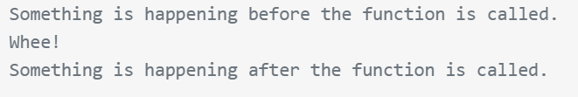
Simple Decorators
def my_decorator(func):
def wrapper():
print("Something is happening before the function is called.")
func()
print("Something is happening after the function is called.")
return wrapper
def say_whee():
print("Whee!")
say_whee = my_decorator(say_whee)
say_whee()
Output

Slide 8
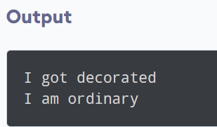
@ Symbol With Decorator
Instead of assigning the function call to a variable, Python provides a much more elegant way to achieve this functionality using the @ symbol.
def make_pretty(func):
def inner():
print("I got decorated")
func()
return inner
@make_pretty
def ordinary():
print("I am ordinary")
ordinary()

Slide 9
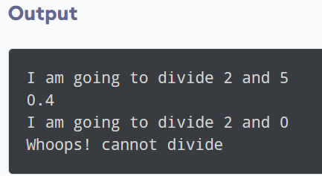
Decorating Functions with Parameters
it only worked with functions that did not have any parameters. What if we had functions that took in parameters like:
def divide(a, b):
return a/b
def smart_divide(func):
def inner(a, b):
print("I am going to divide", a, "and", b)
if b == 0:
print("Whoops! cannot divide")
return
return func(a, b)
return inner
@smart_divide
def divide(a, b):
print(a/b)
divide(2,5)
divide(2,0)

Slide 10
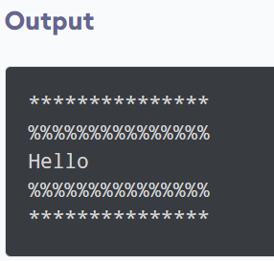
Chaining Decorators in Python
Multiple decorators can be chained in Python.
To chain decorators in Python, we can apply multiple decorators to a single function by placing them one after the other, with the most inner decorator being applied first.
def star(func):
def inner(*args, **kwargs):
print("*" * 15)
func(*args, **kwargs)
print("*" * 15)
return inner
def percent(func):
def inner(*args, **kwargs):
print("%" * 15)
func(*args, **kwargs)
print("%" * 15)
return inner
@star
@percent
def printer(msg):
print(msg)
printer("Hello")

Slide 11
Parallel Processing in Python
Parallel processing can increase the number of tasks done by your program which reduces the overall processing time. These help to handle large scale problems.
Introduction to parallel processing
For parallelism, it is important to divide the problem into sub-units that do not depend on other sub-units (or less dependent). A problem where the sub-units are totally independent of other sub-units is called embarrassingly parallel.
There are two main ways to handle parallel programs:
Shared Memory
Distributed memory

Slide 12
Parallel processing
Shared Memory
In shared memory, the sub-units can communicate with each other through the same memory space. The advantage is that you don’t need to handle the communication explicitly because this approach is sufficient to read or write from the shared memory. But the problem arises when multiple process access and change the same memory location at the same time. This conflict can be avoided using synchronization techniques.
Distributed memory
In distributed memory, each process is totally separated and has its own memory space. In this scenario, communication is handled explicitly between the processes. Since the communication happens through a network interface, it is costlier compared to shared memory.

Slide 13
Parallel processing
Threads are one of the ways to achieve parallelism with shared memory. These are the independent sub-tasks that originate from a process and share memory.
Due to Global Interpreter Lock (GIL) , threads can’t be used to increase performance in Python. GIL is a mechanism in which Python interpreter design allow only one Python instruction to run at a time. GIL limitation can be completely avoided by using processes instead of thread.

Slide 14
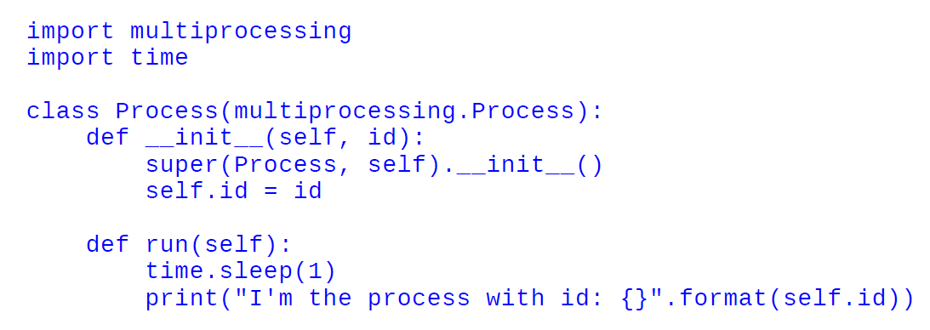
Multiprocessing for parallel processing
Using the standard multiprocessing module, we can efficiently parallelize simple tasks by creating child processes. This module provides an easy-to-use interface and contains a set of utilities to handle task submission and synchronization.
Process class:
By subclassing multiprocessing.process, you can create a process that runs independently. By extending the __init__ method you can initialize resource and by implementing Process.run() method you can write the code for the subprocess. In the below code, we see how to create a process which prints the assigned id::

Slide 15
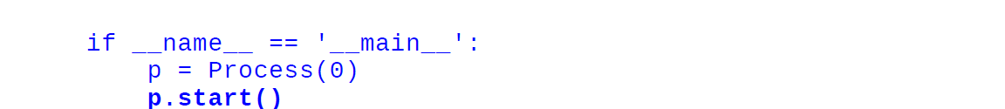
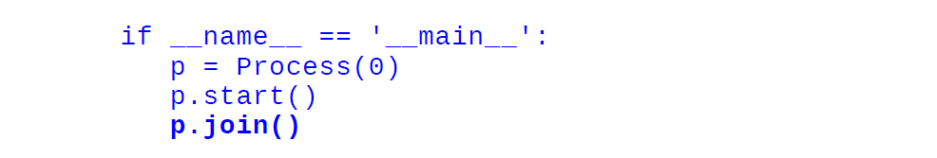
Multiprocessing for parallel processing(process class)
To spawn the process, we need to initialize our Process object and invoke Process.start() method. Here Process.start() will create a new process and will invoke the Process.run() method.
The code after p.start() will be executed immediately before the task completion of process p. To wait for the task completion, you can use Process.join().

Slide 16
Multiprocessing for parallel processing(process class)
import multiprocessing
import time
class Process(multiprocessing.Process):
def __init__(self, id):
super(Process, self).__init__()
self.id = id
def run(self):
time.sleep(1)
print("I'm the process with id: {}".format(self.id))
if __name__ == '__main__':
p = Process(0)
p.start()
p.join()
p = Process(1)
p.start()
p.join()

Slide 17
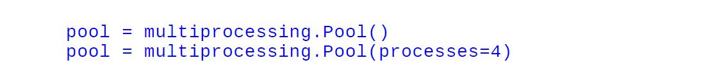
Multiprocessing for parallel processing(pool class)
Pool class can be used for parallel execution of a function for different input data.
The multiprocessing.Pool() class spawns a set of processes called workers and can submit tasks using the methods apply/apply_async and map/map_async.
For parallel mapping, you should first initialize a multiprocessing.Pool() object.
The first argument is the number of workers; if not given, that number will be equal to the number of cores in the system.

Slide 18
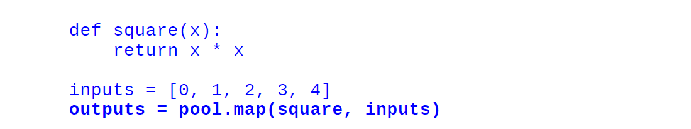
Multiprocessing for parallel processing(pool class)
Let see by an example. In this example, we will see how to pass a function which computes the square of a number. Using Pool.map() you can map the function to the list and passing the function and the list of inputs as arguments, as follows:

Slide 19
Pool process full code
import multiprocessing
import time
def square(x):
return x * x
if __name__ == '__main__':
pool = multiprocessing.Pool()
pool = multiprocessing.Pool(processes=4)
inputs = [0,1,2,3,4]
outputs = pool.map(square, inputs)
print("Input: {}".format(inputs))
print("Output: {}".format(outputs))

Slide 20
Generators in Python
A generator-function is defined like a normal function, but whenever it needs to generate a value, it does so with the yield keyword rather than return. If the body of a def contains yield, the function automatically becomes a generator function.
Generator functions return a generator object. Generator objects are used either by calling the next method on the generator object or using the generator object in a “for in” loop.
A generator function returns an generator object that is iterable, i.e., can be used as an Iterators .

Slide 21
What is the need of generator?
Suppose we create a stream of Fibonacci numbers, adopting the generator approach makes it trivial; we just have to call next(x) to get the next Fibonacci number without bothering about where or when the stream of numbers ends.
A more practical type of stream processing is handling large data files such as log files. Generators provide a space-efficient method for such data processing as only parts of the file are handled at one given point in time.
It is useful when we are handling large data ad don’t want to populate the memory.

Slide 22
Create Python Generator
In Python, similar to defining a normal function, we can define a generator function using the def keyword, but instead of the return statement we use the yield statement.
def generator_name(arg):
#statements
yield something

Slide 23
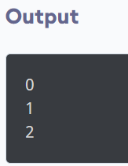
Example of a python generator
def my_generator(n):
# initialize counter
value = 0
# loop until counter is less than n
while value < n:
# produce the current value of the counter
yield value
# increment the counter
value += 1
# iterate over the generator object produced by my_generator
for value in my_generator(3):
# print each value produced by generator
print(value)

Slide 24
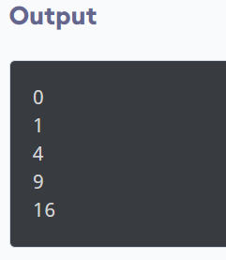
Python Generator Expression
In Python, a generator expression is a concise way to create a generator object.
It is similar to a list comprehension, but instead of creating a list, it creates a generator object that can be iterated over to produce the values in the generator.
Generator Expression Syntax
(expression for item in iterable)
# create the generator object
squares_generator = (i * i for i in range(5))
# iterate over the generator and print the values
for i in squares_generator:
print(i)

Slide 25
Use of Python Generators
There are several reasons that make generators a powerful implementation.
1. Easy to Implement
Generators can be implemented in a clear and concise way as compared to their iterator class counterpart.
2. Memory Efficient
A normal function to return a sequence will create the entire sequence in memory before returning the result. This is an overkill, if the number of items in the sequence is very large.
Generator implementation of such sequences is memory friendly and is preferred since it only produces one item at a time.

Slide 26
Use of Python Generators
3. Represent Infinite Stream
Generators are excellent mediums to represent an infinite stream of data. Infinite streams cannot be stored in memory, and since generators produce only one item at a time, they can represent an infinite stream of data.
4. Pipelining Generators
Multiple generators can be used to pipeline a series of operations. This is best illustrated using an example.
Suppose we have a generator that produces the numbers in the Fibonacci series. And we have another generator for squaring numbers.

Slide 27
Example of generator
def fibonacci_numbers(nums):
x, y = 0, 1
for _ in range(nums):
x, y = y, x+y
yield x
def square(nums):
for num in nums:
yield num**2
print(sum(square(fibonacci_numbers(10))))
# Output: 4895

Slide 28
Thank You

